Slide 1
Disease ecologist
wildlife-domestic animals-human interface
emerging diseases
Background in veterinary medicine and conservation research

Slide 2
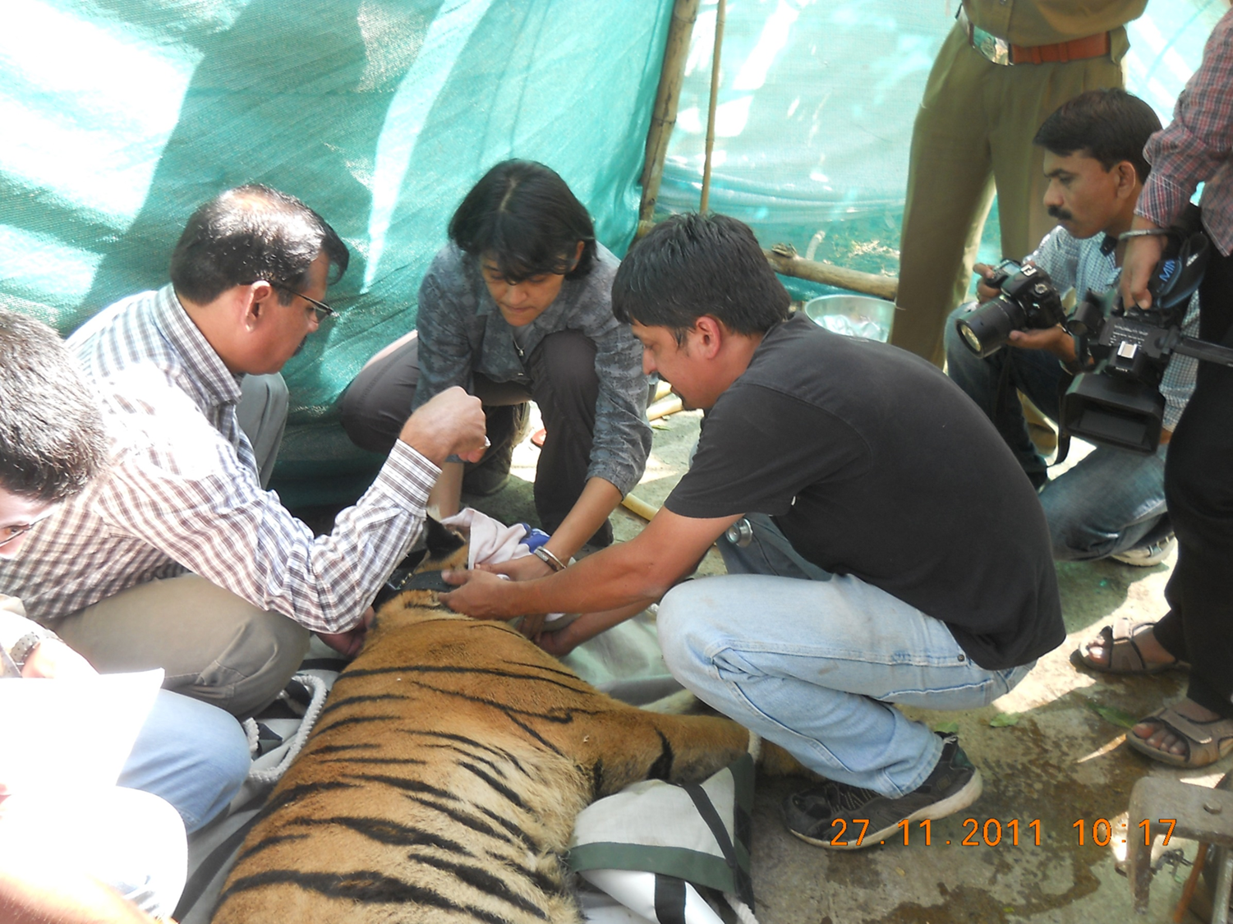
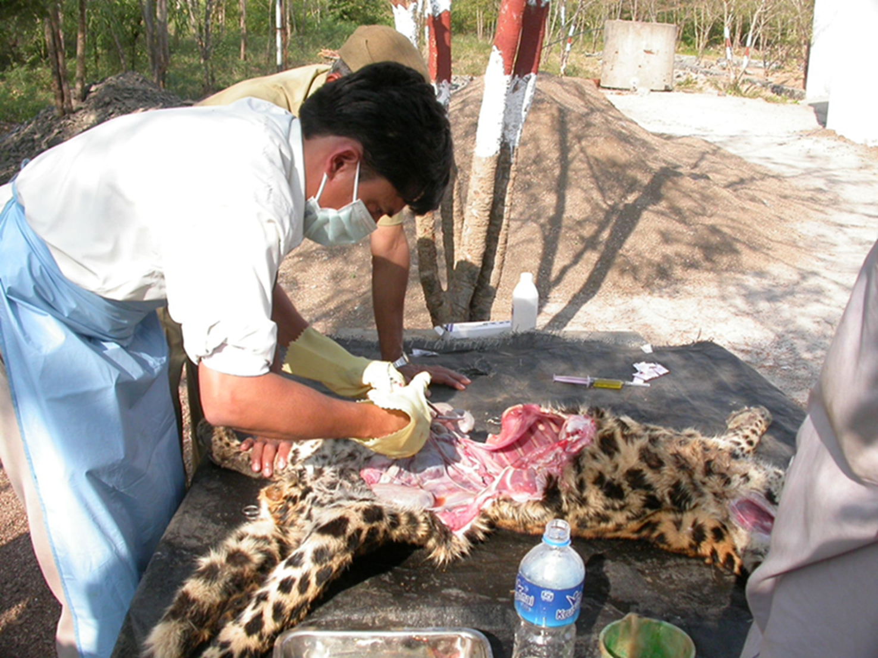
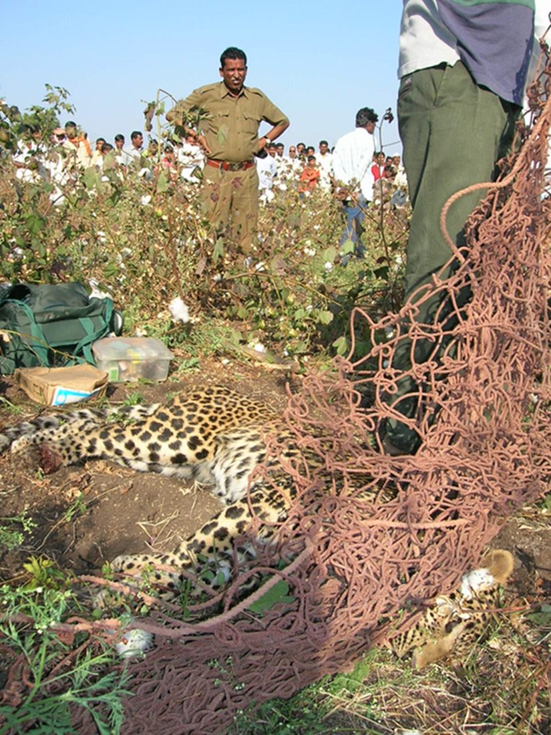
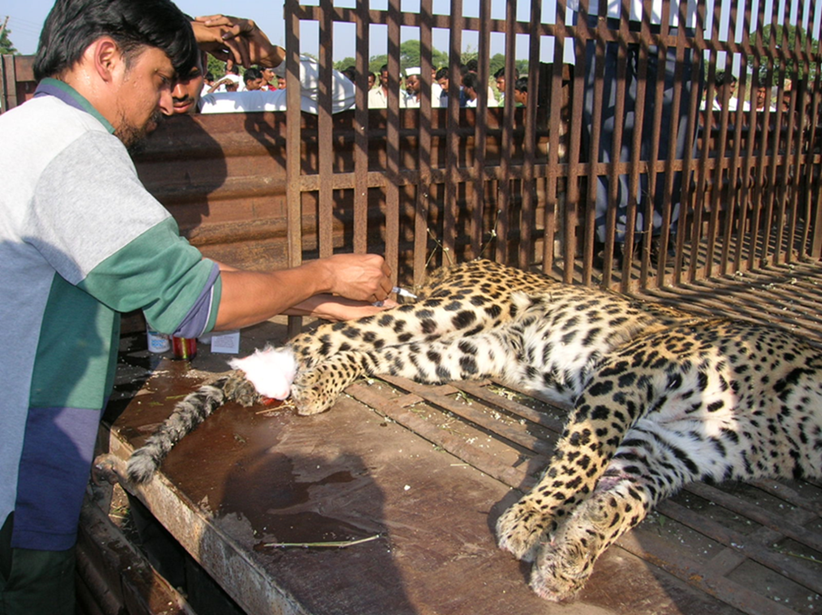

Slide 3
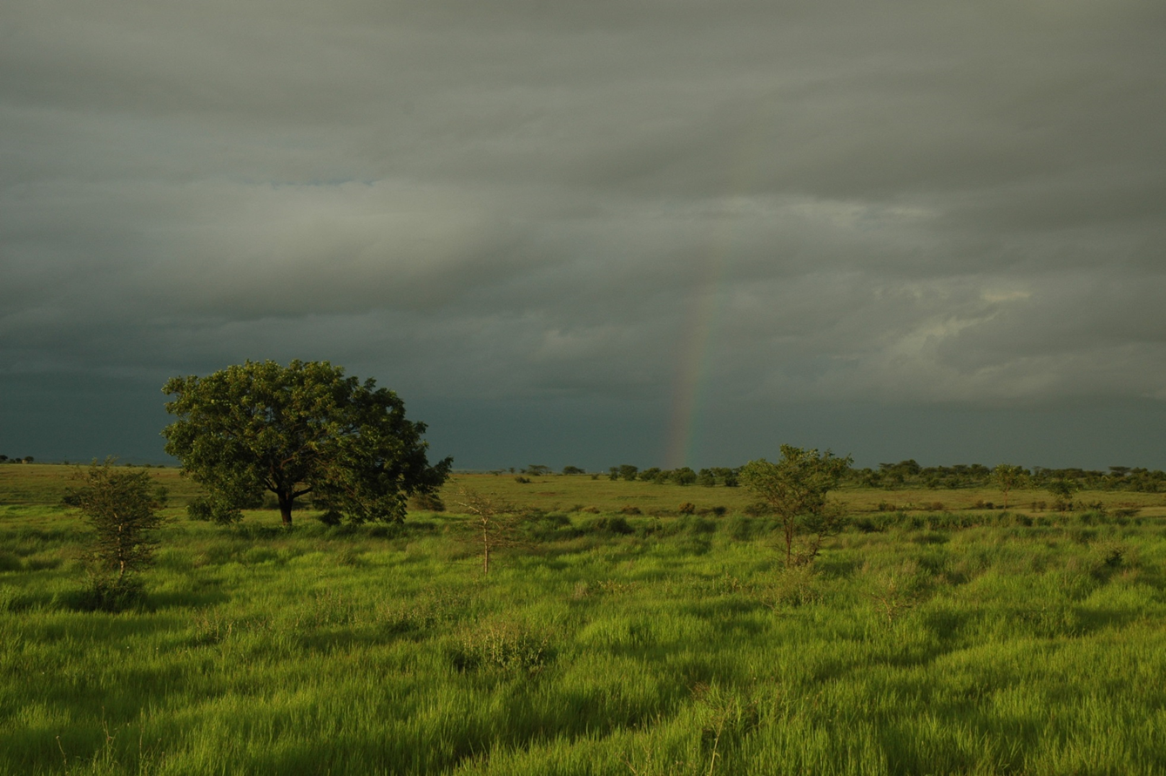
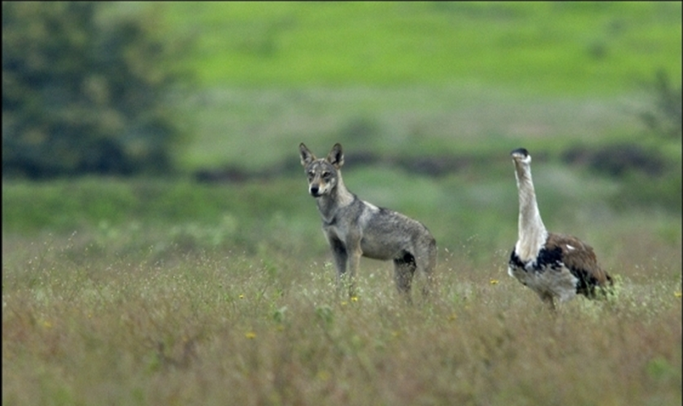
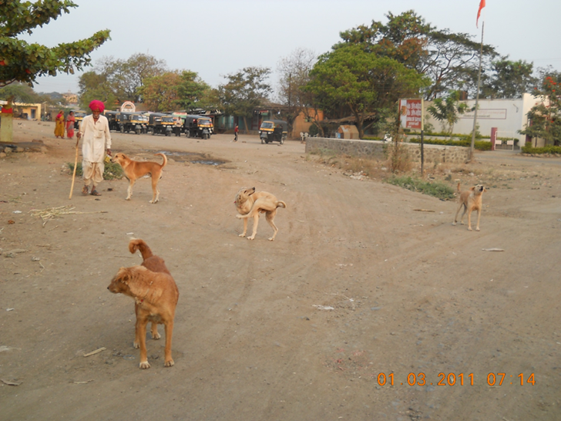
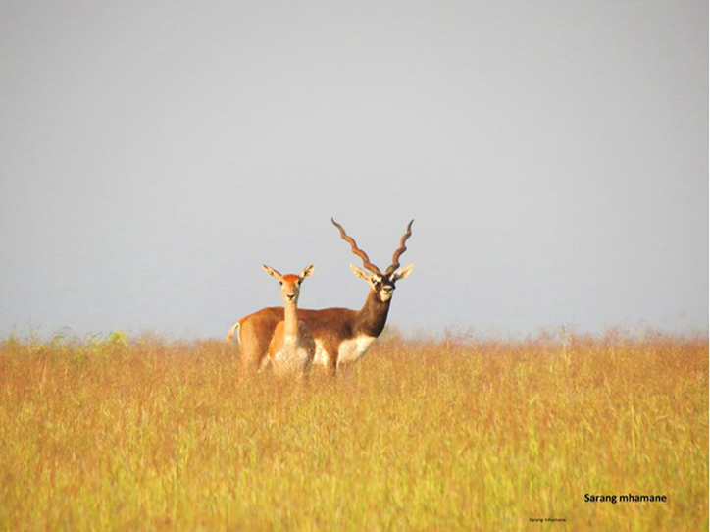
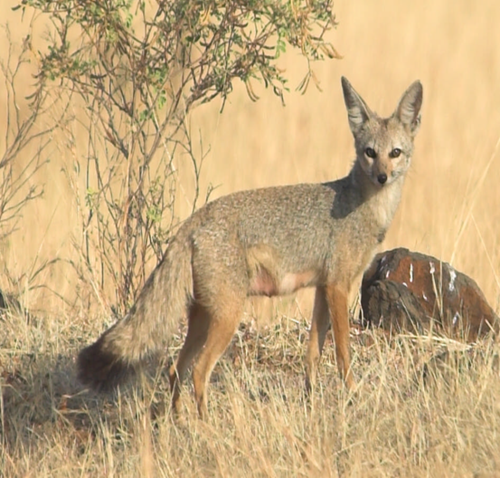
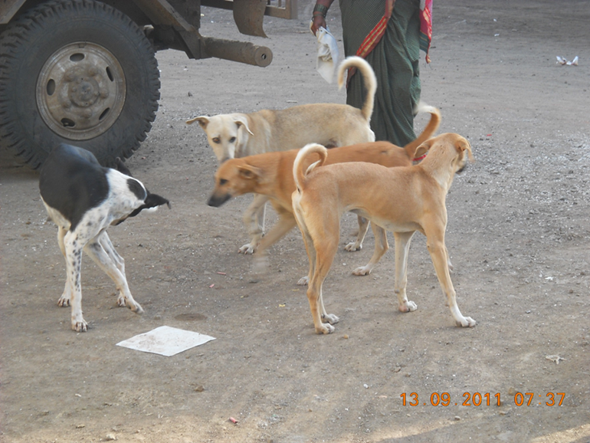
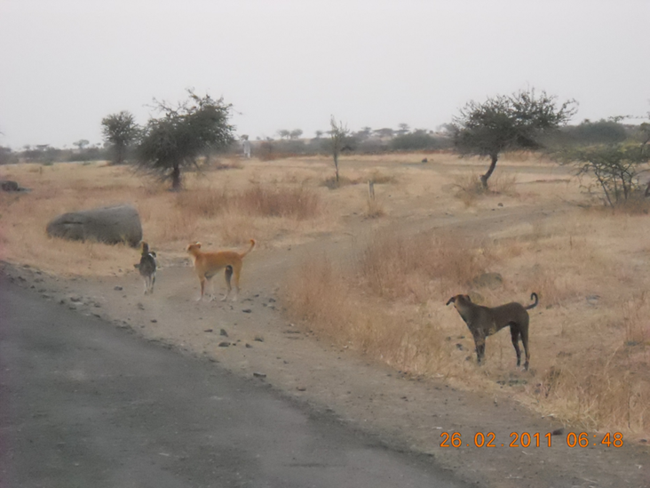
Notes:
Behavior, health parameters, ecology differ markedly between categories
Human-dog interaction

Slide 4
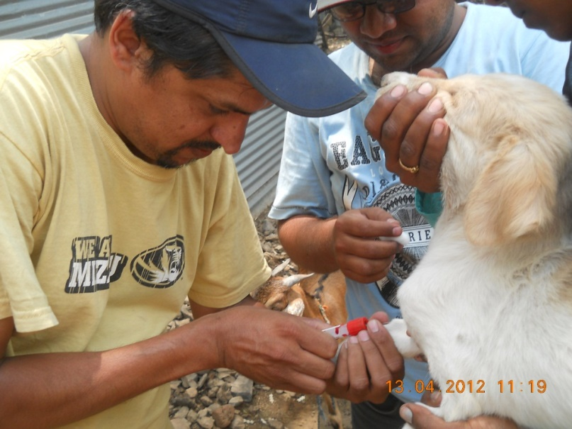
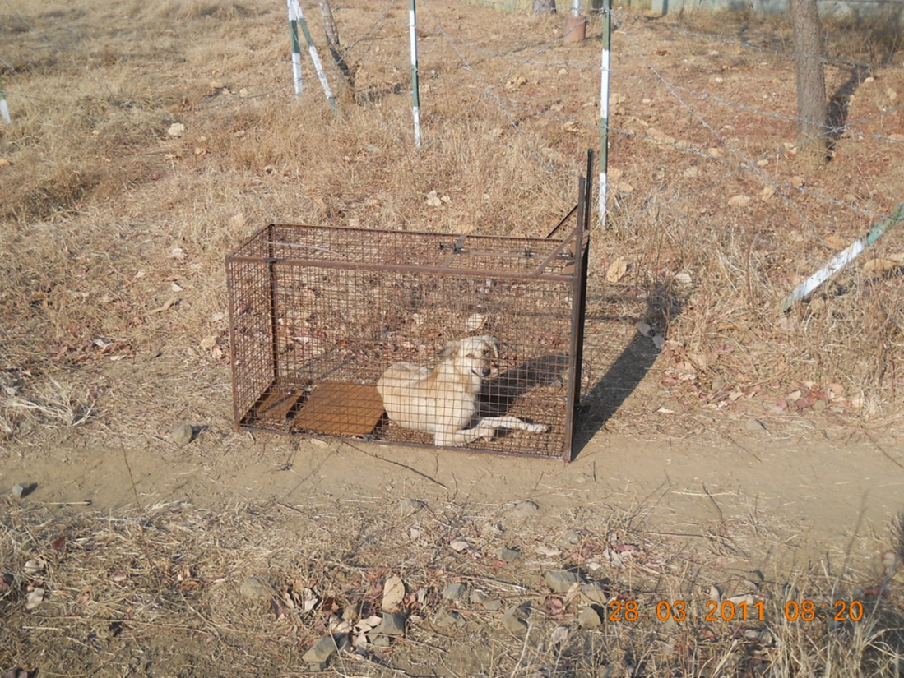
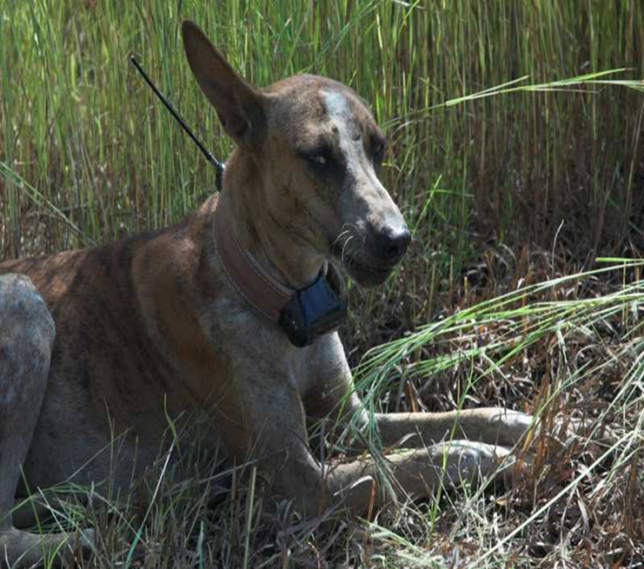
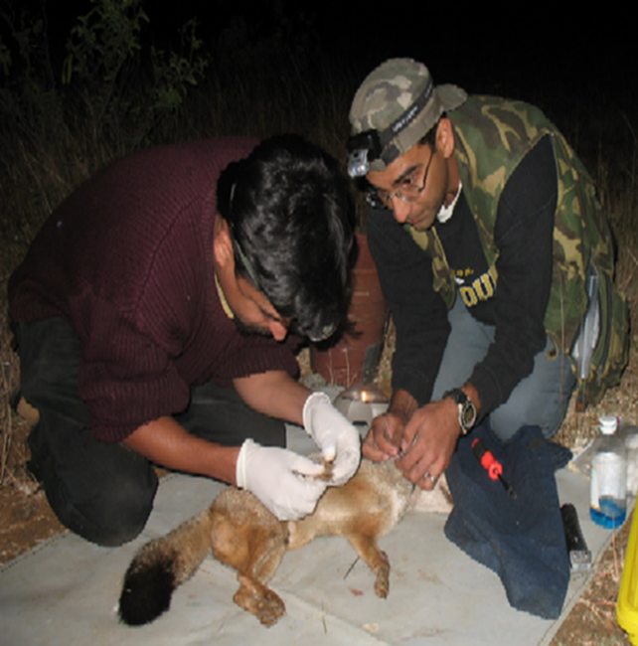
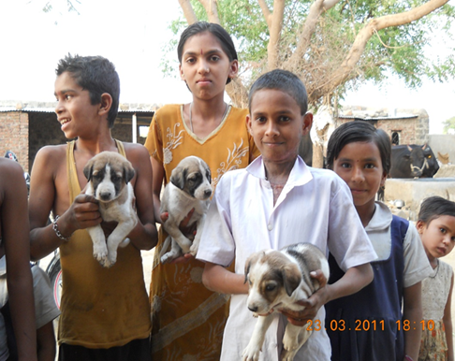
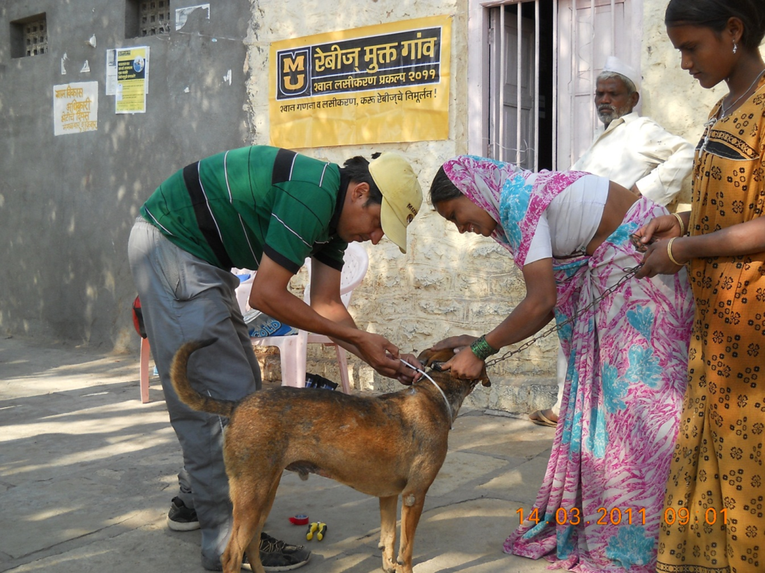
Notes:
Being a veterinarian, I decided to make use of this opportunity to undertake a demographic and epidemiologic assessment of the dog populations.
Mass vaccination campaigns provided an opportunity for demographic and epidemiologic assessment of dog populations. By using the assistance of putative owners/reference persons, and in some cases using box traps, dogs were handled on several occasions between 2011 and 2013 (~700 individuals handled on ~1200 occasions) without a single instance of dog bite (to the handlers or onlookers) and no injury to the dog.

Slide 5

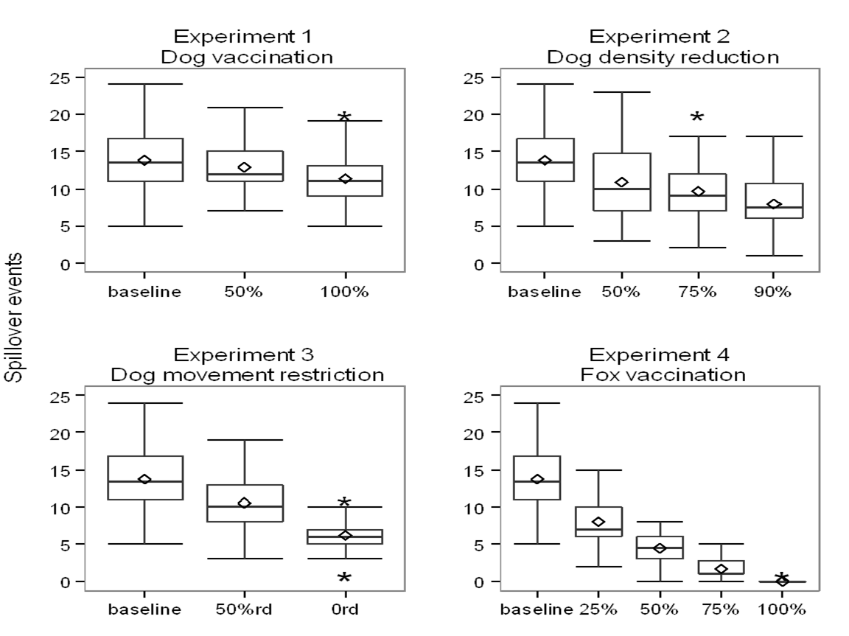
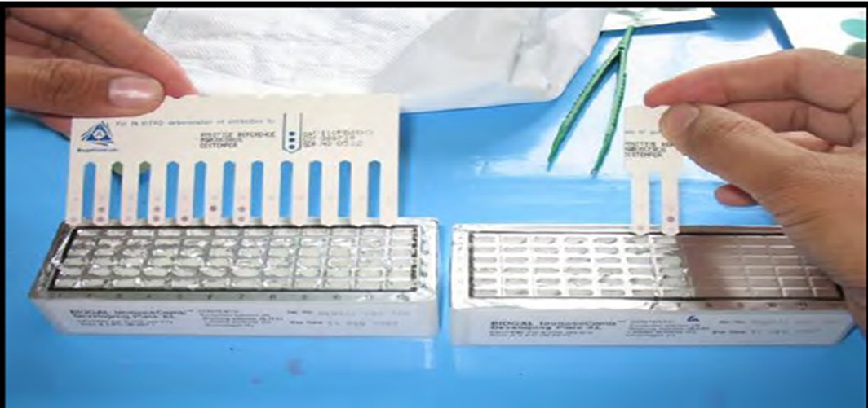

Slide 6
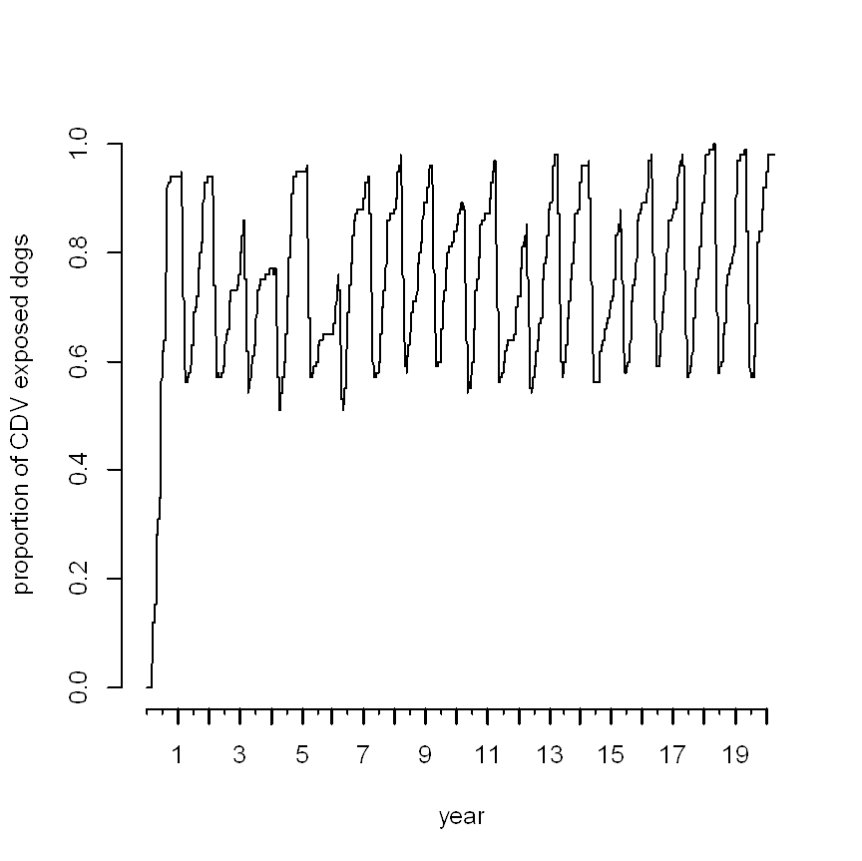
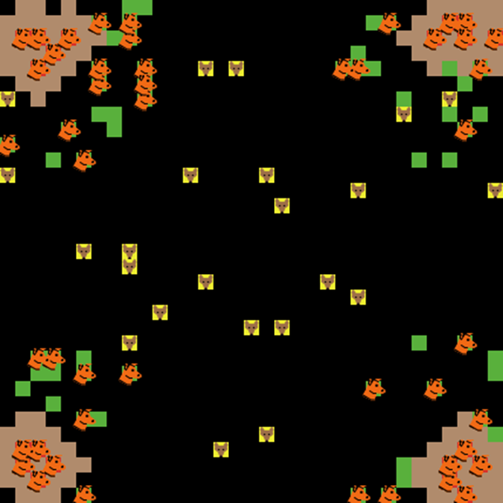
Belsare, A.V., Gompper, M.E., 2015. A model-based approach for investigation and mitigation of disease spillover risks to wildlife: Dogs, foxes and canine distemper in central India. Ecological Modelling 296, 102-112.
Notes:
coding using NetLogo and R, PARAMETERIZED WITH FIELD DATA
The basic reproductive number (R0) for CDV in the model fox population was 0.85, indicating that CDV could not be independently sustained in the fox population.
The model was then used to compare and contrast potential management strategies to mitigate CDV spillover risks.
Vaccination of local dog populations was an ineffective disease control strategy, while fox vaccination was highly effective.
Interventions potentially resulting in lower contact rates between dogs and foxes, like reduction in village dog density and restricting dog movements in fox habitat, implemented in a sustained and integrated manner would be most effective in mitigating disease threats to foxes.
Integrating Ecology, Epidemiology and Model Explorations to Address Disease Threats

Slide 7

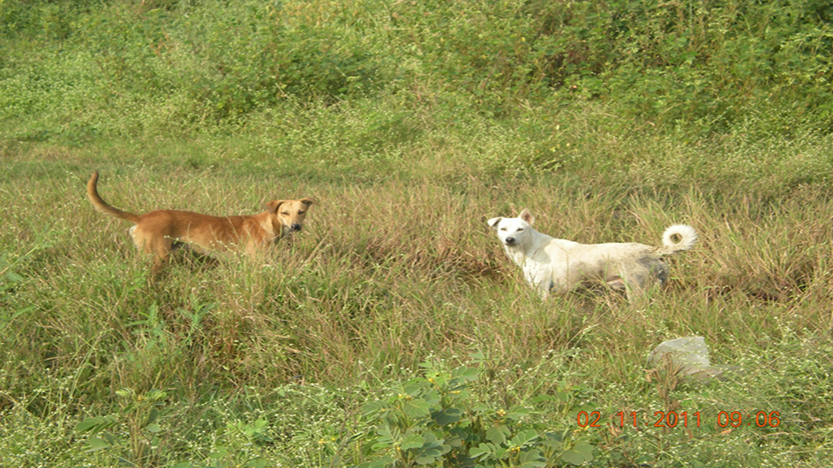
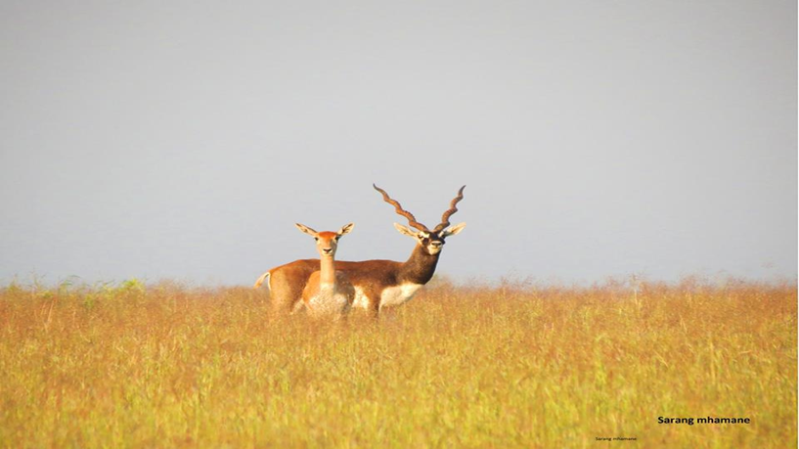


Slide 8
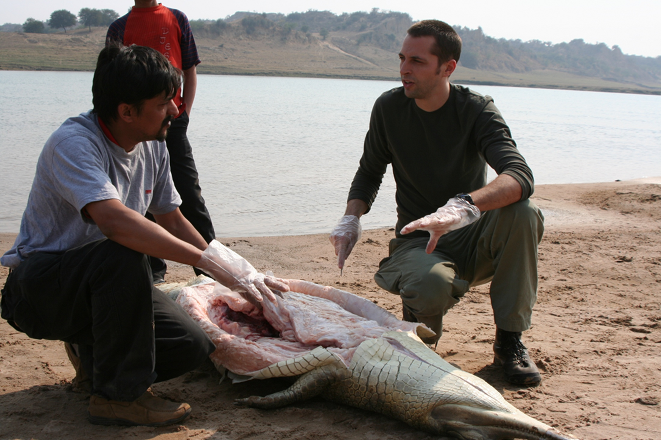

Slide 9


Slide 10


Slide 11
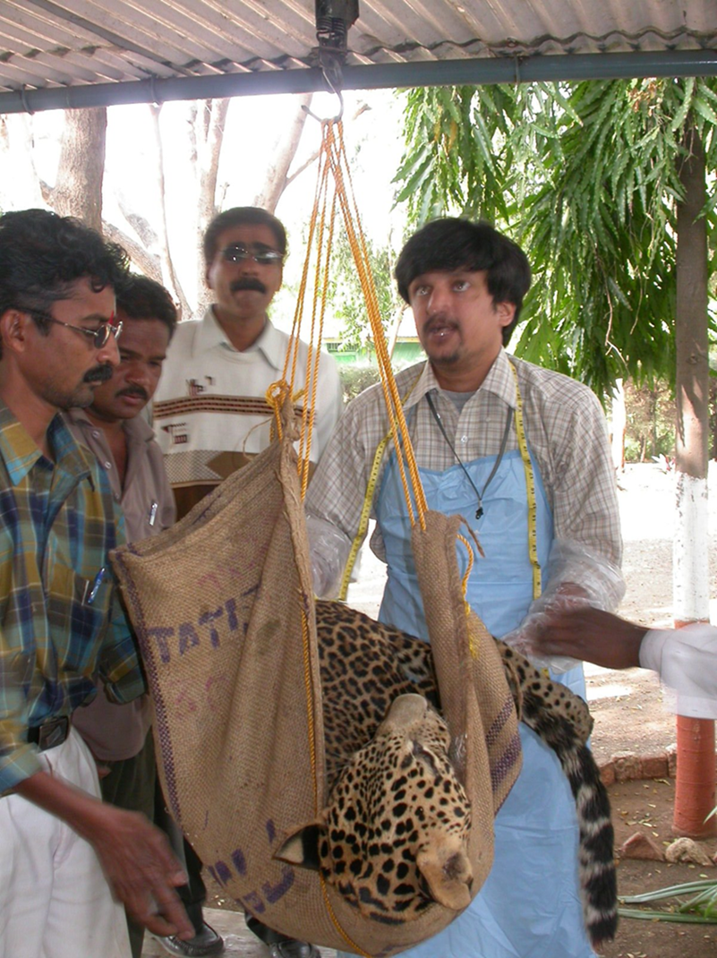

Slide 12


